Slide 1
Digital Presentation English
Members: Gonzalo Lopez.
Octavio Jury.
Martina Andrada.
Course: 6° “A”.
College: Santa Rosa de Lima.
Teacher: Natalia Leotta. Year: 2022.

Slide 2
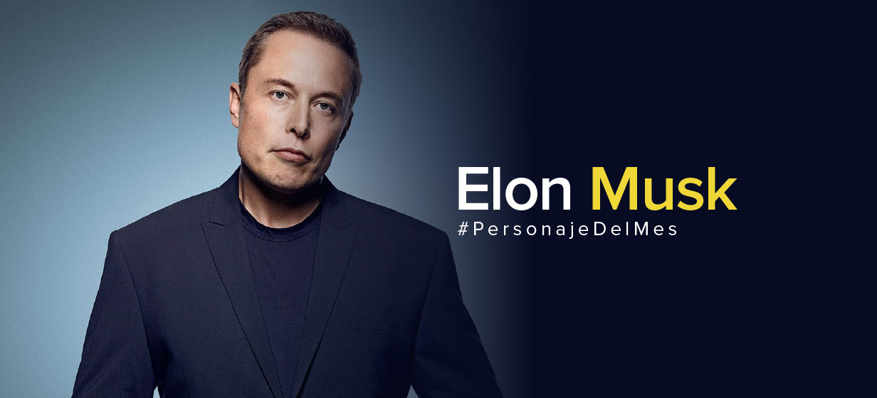
Elon Reeve Musk
Elon Reeve Musk is the world’s largest billionaire, he was named the richest man on earth in 2021 and has been considered the most successful businessman of 2020 despite the global situationHe is a media mogul, businessman, and philanthropist, he is the Founder, CEO and CTO of SpaceX, co-founder of tesla Motor’s and founder of the Boring Company. he’s also the co-founder of Neuralink, OpenAI and PayPal
"Patience is a virtue, and I am learning patience. It is a hard lesson"

Slide 3
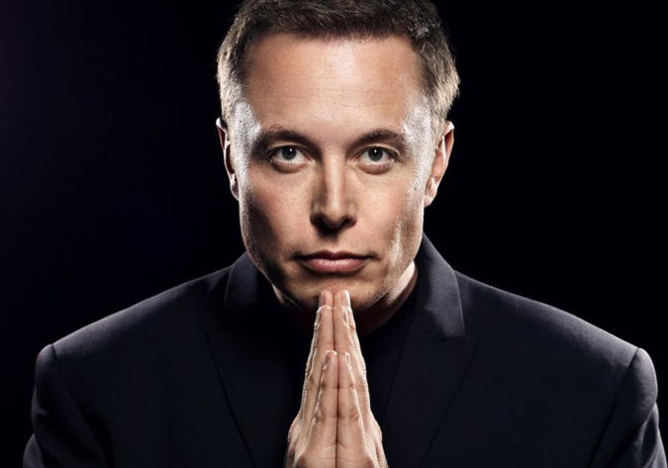
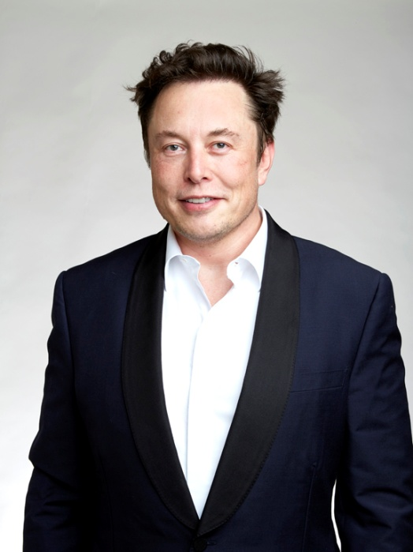
He suffers Asperger Syndrome (a behavior disorder that affects the ability to socialize and communicate effectively), it comes from a branch of autism, because of this, many former employees say that he’s workaholic, obssesive and has a strong and overwhelming character
He is currently 51 years old. He was born on June 28, 1971 in Pretoria, South Africa. His mother is from Canada and his father from South Africa, he grew up in Pretoria, South Africa. His nationality is Canadian and North American. He studied briefly at the university of Pretoria before moving to Canada at his 17. He enrolled to Queen’s University and transferred to the university of Pennsylvania two years later where he received degrees of Physics and Economics

Slide 4
END.
Gonzalo Lopez. Octavio Jury. Martina Andrada.

