Slide 1
The story of Leandro Witruk
is an example of struggle and improvement

Slide 2
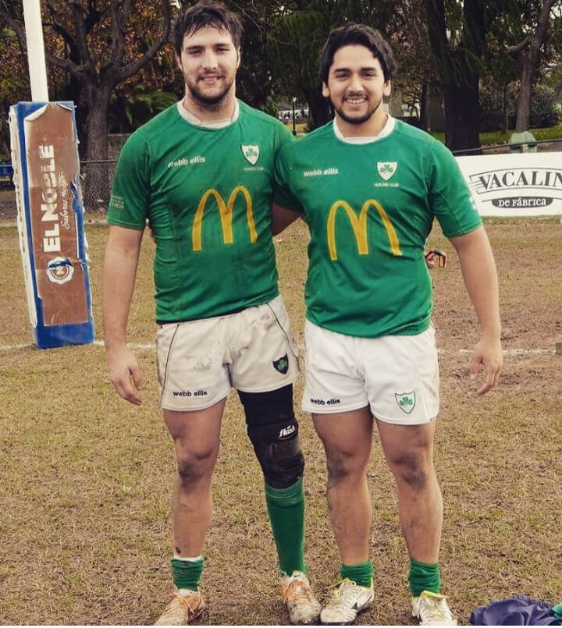
Important data
Leandro, alias Patita, was born without a leg. Despite this, today he plays rugby and is the only one on the team who has this disability
Despite this, today he plays rugby and is the only one on the team who has this disability
At nine months he had his first prosthesis and at thirteen months he took his first steps

Slide 3
A little of you history
Since he was a child, Leandro has practiced several sports, such as swimming, soccer and volleyball. “They were not sports that filled me completely, until one day I learned about rugby through a friend who had started playing. So, I mentioned it to my parents and told them that I wanted to try it too.”
I started playing rugby when I was 15 years old. Today, he is 27 years old and continues to play and enjoy it with the same passion. “One day I plucked up courage and together with my mom we went to the Hurling Club.

Slide 4
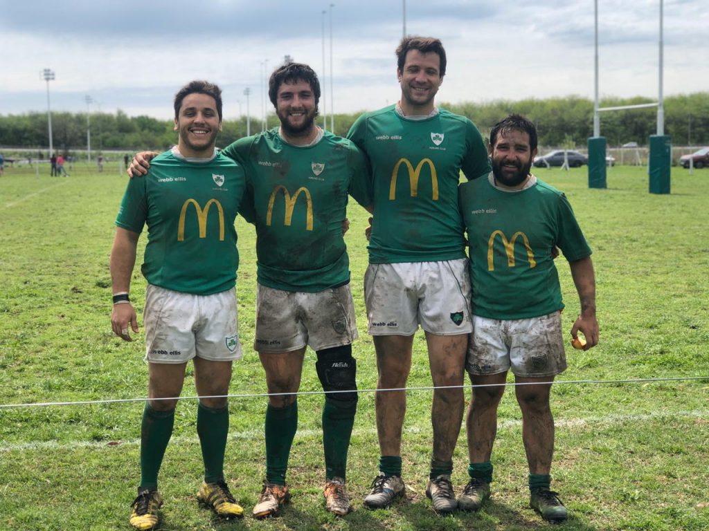

Slide 5
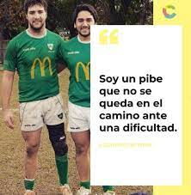
important message
“I am a kid who does not stay on the road in the face of a difficulty, All of this makes you think that any difficulty can be overcome”,

