Slide 1
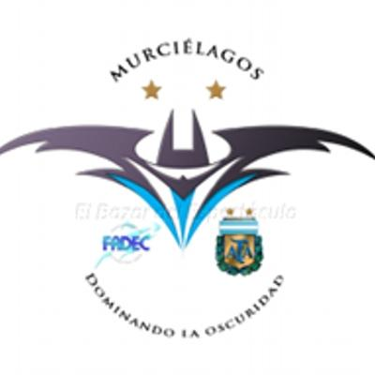
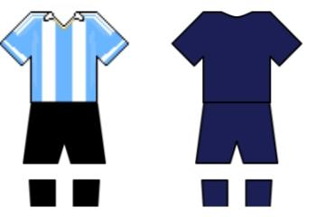
LOS MURCIELAGOS
Argentine soccer team for the blind

Slide 2

The Male Blind Football selction of Argentine, known as Bats, is a representative selection of male Argentine of football 5, in its form adapted for blind or visually impaired people, known as blind fotball. It represents Argentine in the Paralympic Games that take place every four years and in the World Blind Soccer Championship, organizado by the International Federation of Sports for the Blind (IBSA). They train daily at CeNARD (Nacional Center for High Sports Performance) and are part of FaDec (Argentine Federation of Sports for the Blind).

Slide 3
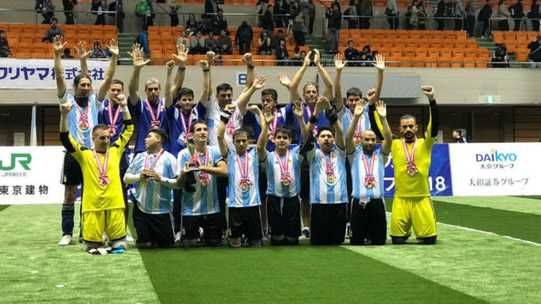
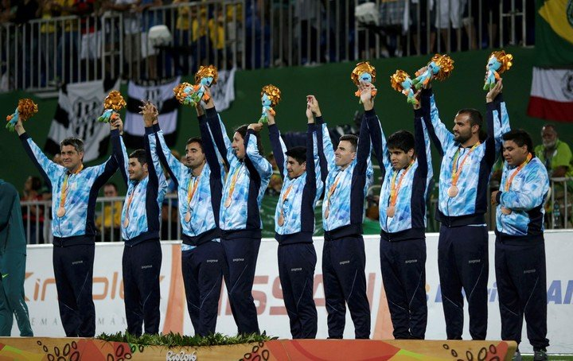
Achievements of Argentine in Football for the Blind
The Murcielagos won two world championships (2002 and 2006), the gold medal at the 2015 IBSA World Games for the Blind, a silver medal (2004) and two bronze (2008 and 2016) at the Paralympic Games , three runners-up world championships (1998, 2000 and 2014), three American championships (1993, 2005, 2017), four silver medals at the Parapan American Games (2007, 2011, 2015, 2019) and two runners-up at the Copa América (2009 and 2013) .

Slide 4
Statements by Silvio Velo Captain of the 2014 Team
“I was born with obstacles to overcome. I was born poor. I think that I‘ve been able to overcome these obstacles because I‘ve decided not to complain about what I didn‘t have. I think that I actually can see, that anyone can see his own way. You may not see with conventional eyes but you see with your heart, which is seeing beyond what the eyes can see.”

Slide 5
Bibliography
https://second.wiki/wiki/seleccic3b3n_de_fc3batbol_para_ciegos_de_argentina
https://m.youtube.com/watch?v=_cdFgYYG9o0

Slide 6
Group members
Martin, Leota
Josefina, Ortis
Bianca, Mora
Oliverio, Werner
Pilar, Sánchez

