Slide 1
Stephen Hawking
Malena Cornejo, Camila Gomez, Valentin Agüero, Nayeli Reus

Slide 2
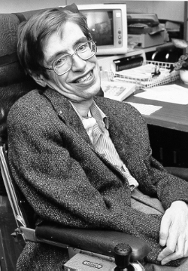
Biography
Stephen Hawking(Stephen William Hawking; Oxford, 1942 - Cambridge, 2018)British theoretical physicist. Despite his physical disabilities andthe progressive limitations imposed by the degenerative diseasehe suffered from, Stephen Hawking is probably the best-knownphysicist among the general public since the days of Einstein.Fighter and winner, throughout his life he preferred to overcomethe immensity of impediments posed by Lou Gehrig's disease,amyotrophic lateral sclerosis that afflicted him since he wastwenty years old. Hawking was, without a doubt, a particular case of vitality and resistance in the face of fate's misfortune

Slide 3
Some of his awards
Profesor Stephen Hamiing received thirteen honorary degrees
He wes awarded CBE (1982)
Companion of Honour (1989)
The Presidential Medal of Freedom (2009)
He was the recipient of many awards, most notably the FundaPhysics prize (2013)
Copley Medal (2006)
The Wolf Foundation prize (1988)
He was a Fellow of the Royal Society and a member of the UAcademy of Solences and the Pontifical Academy of Science

Slide 4
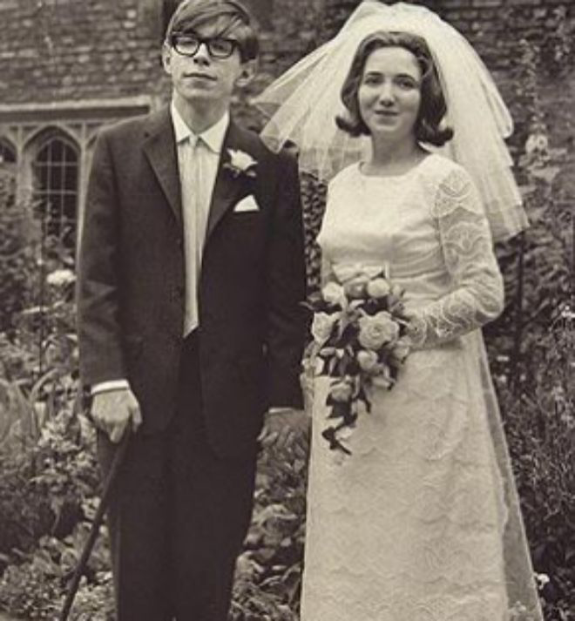
Her relationships
While he was pursuing his doctorate, he met Jane Wayline (1965), with whom he hasthree children. After almost twenty-five years of life together, in 1990 the coupleseparated and the scientist went to live with Elaine Mason, one of the nurses who tookcare of him and with whom he married five years later; this second relationship wouldlast until 2007.

