Slide 1
Gustavo Fernandez
Members: Tiziano Aubone,Fausto Soler,Luciano Facchineli,Fernando Agudo
Subject: English
Teacher: Natalia Leotta
Colegio Santa Rosa de Lima

Slide 2
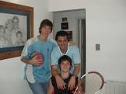
History:
He was born in 20th anuary, 1994. He is 28 years old. He has played since 2007. He was born in Rio Tercero. When he was a year and a half old, he suffered a spinal cord infarction that left him paralyzed from the waist down. He has been playing tennis since he was 6 years old and at 12 he began his career when he registered whit the argentine tennis association to be a junior player.

Slide 3
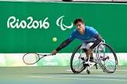
Gustavo Fernández
Gustavo Fernández is an Argentine weel chair tennis player. He was Champion of The Roland Garros tournament in 2016 and 2019, in addition to the Australian Open in 2017 and 2019 and the Wimbledon Championship in 2019. He is top 2 of his it ranking world.

