Slide 1
THE 2000s ERA

Slide 2
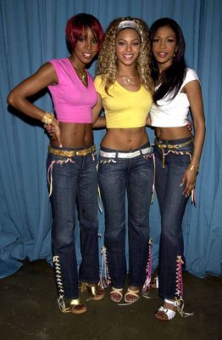
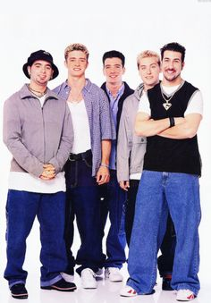
FASHION:
The 2000s were a fashion tren, women themselves up whit low-waisted pants and body hugging shirts ,men wore loose clothing.
:

Slide 3
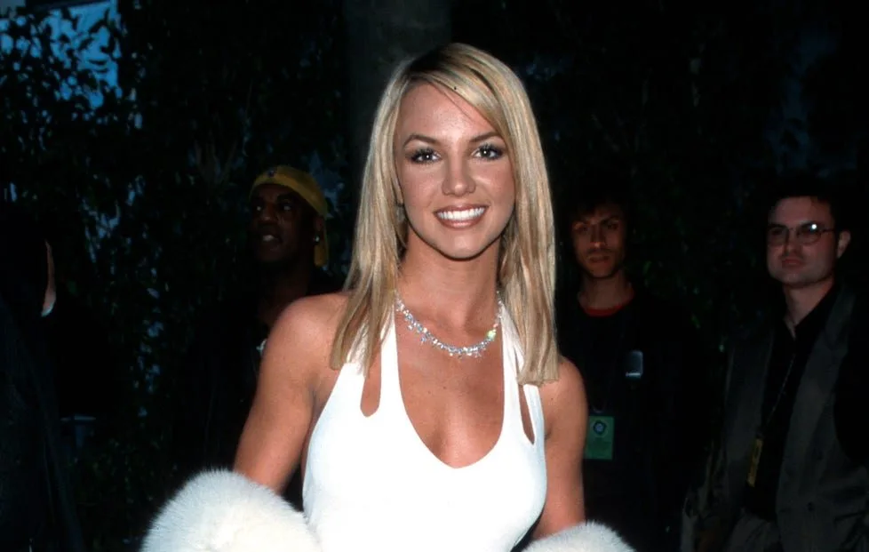
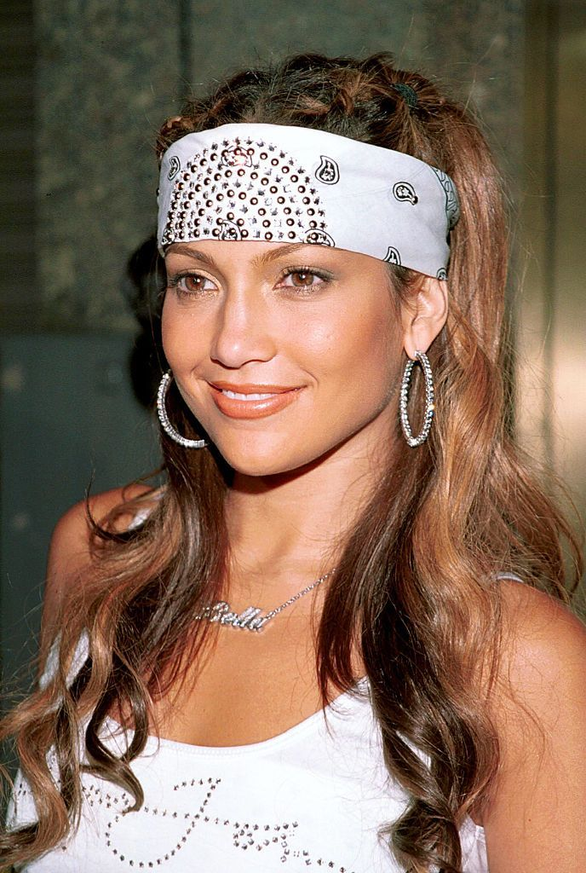
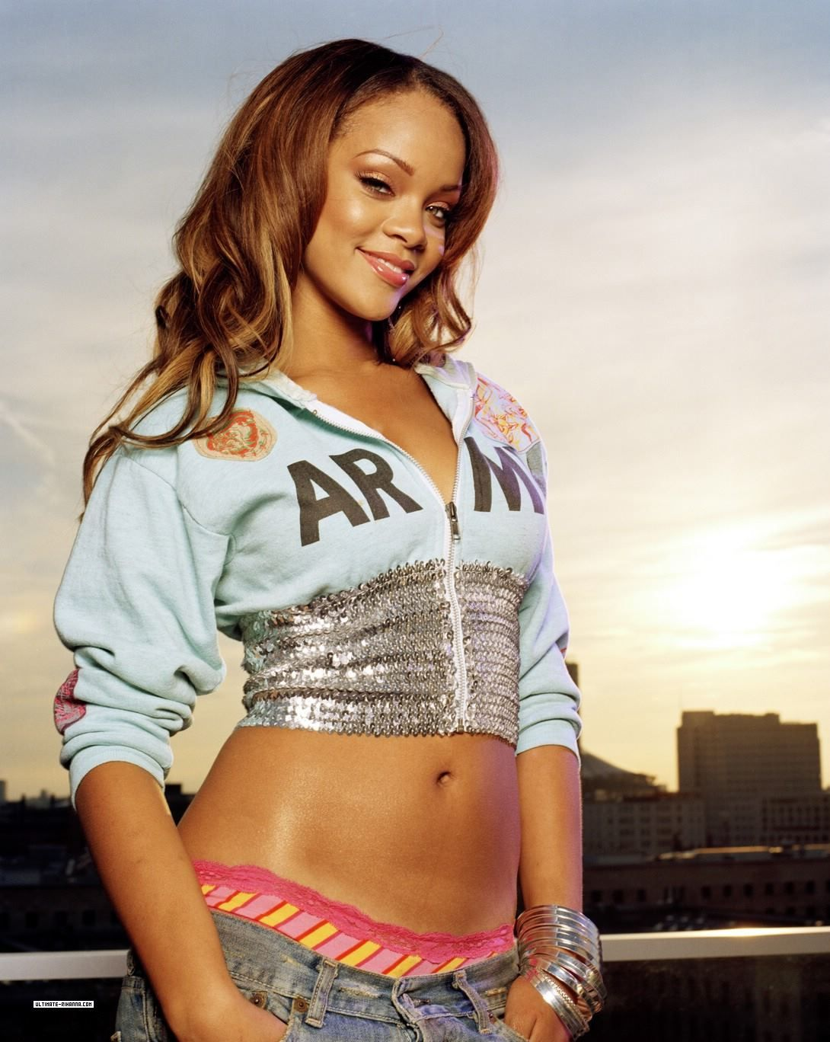
MUSIC:
The most popular artists of the 2000s were:
_BRITNEY SPEARS
_JENNIFER LOPEZ
_RHIANNA

Slide 4
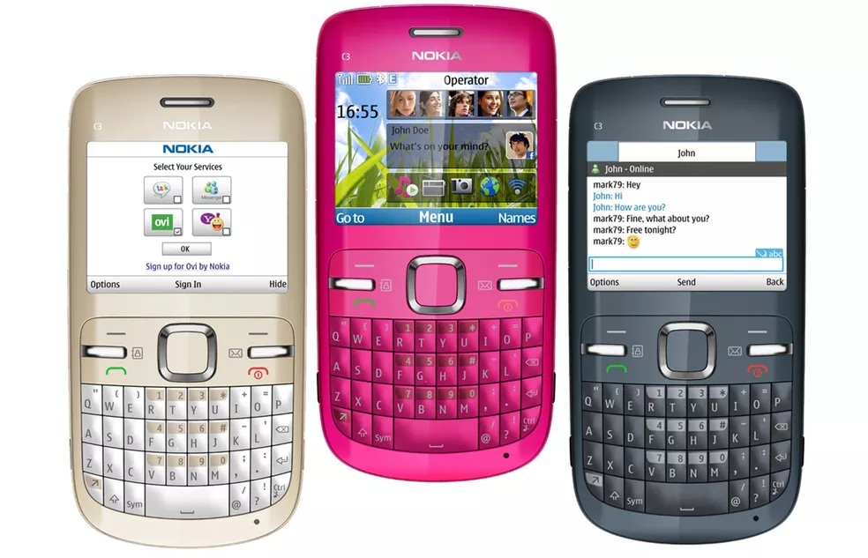
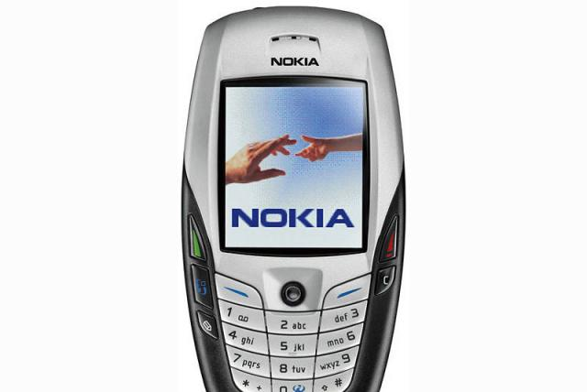
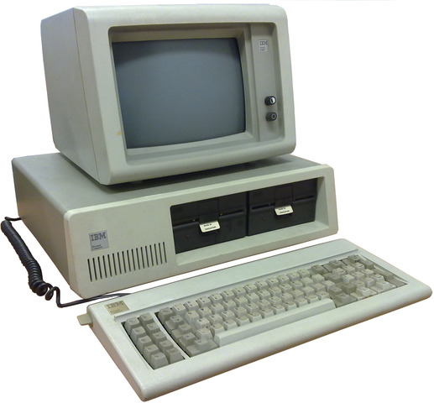
TECHNOLOGY:
In the 2000s there were al ready electronic devices such as the computer and the Nokia cell phone

Slide 5
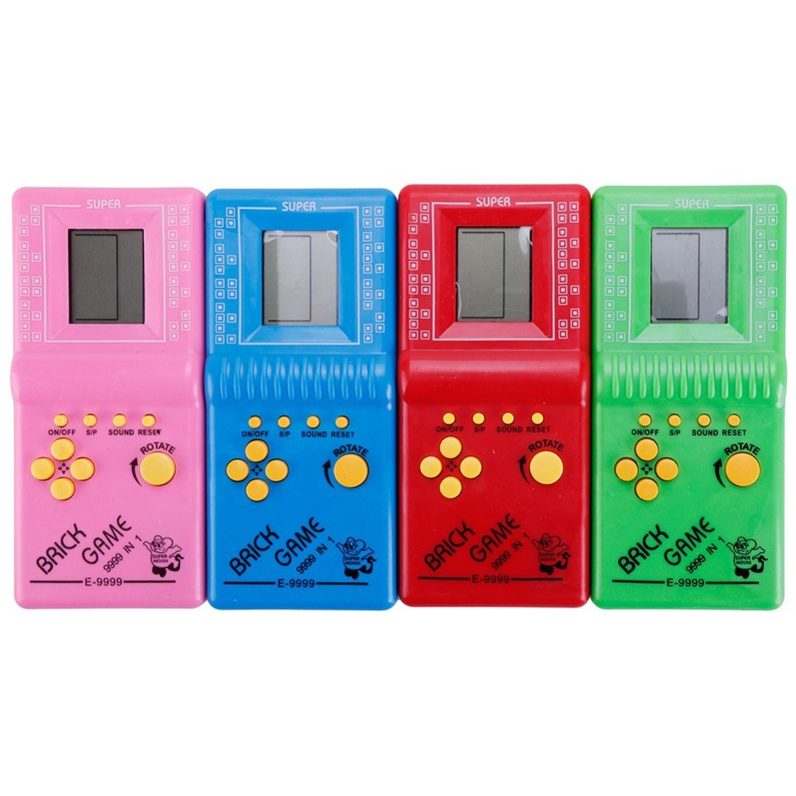
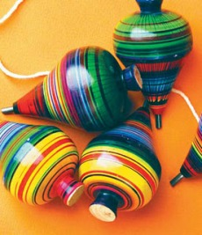
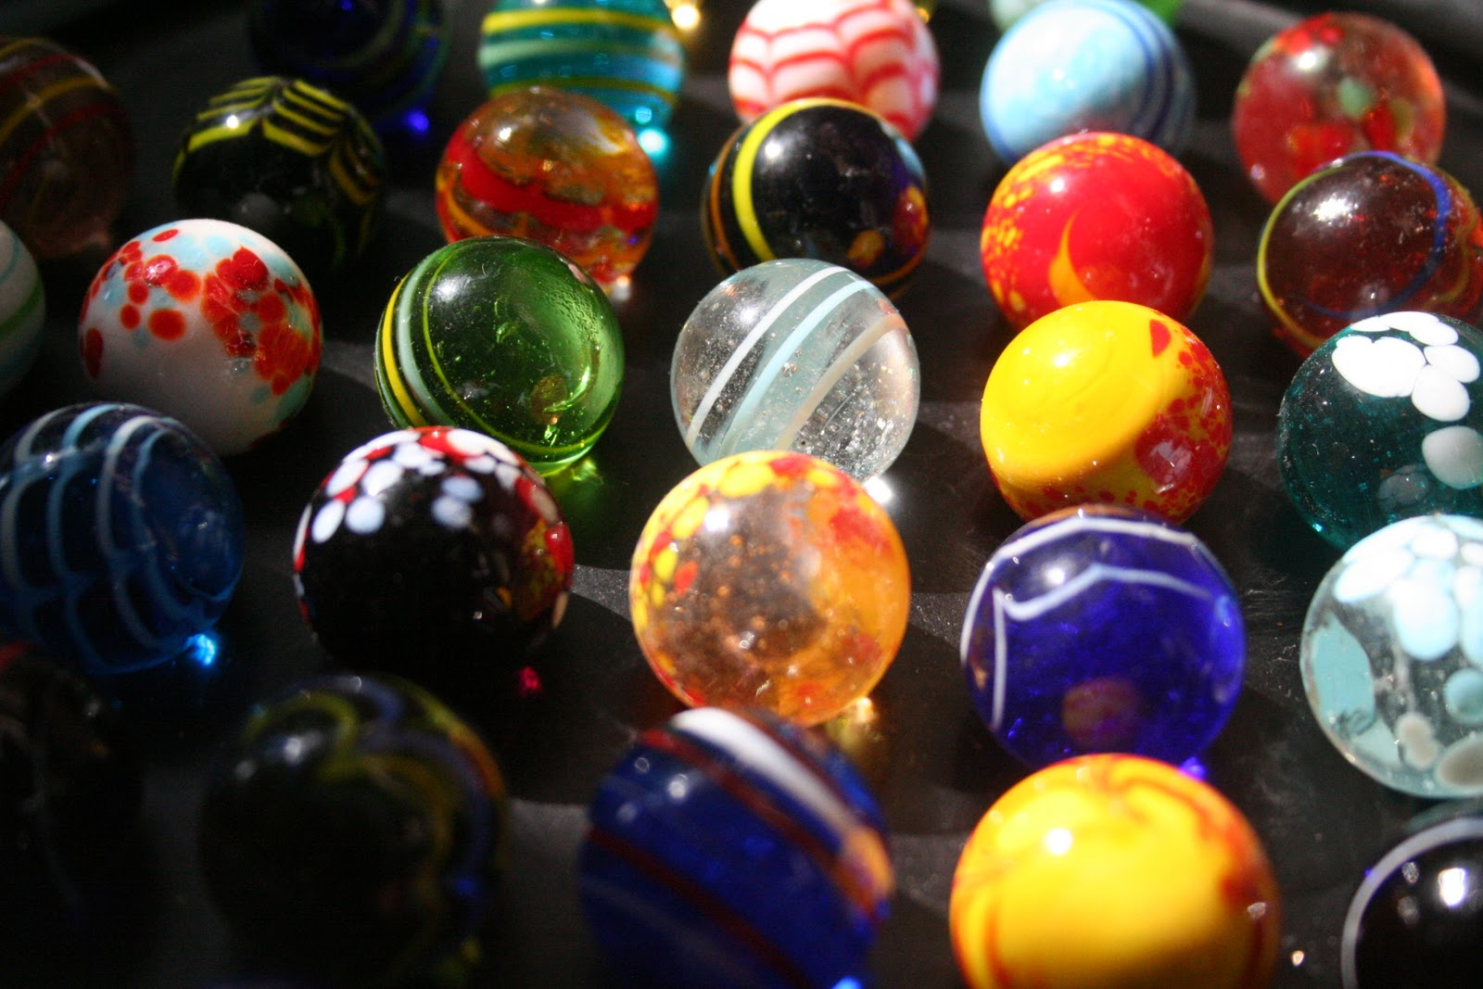
CRAZES:
The games that were fashion bles in the 2000s were :
_Classic game console
_Trimpos
_Marbles

