Slide 1
THE 60’s ERA

Slide 2
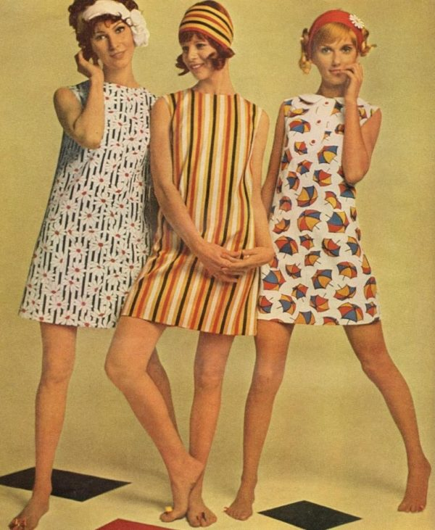
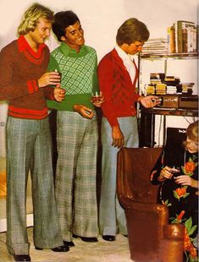
It is characterized by a fun and even childish touch where miniskrits, White boots and babydoll dresses were the leading garments
FASHION

Slide 3
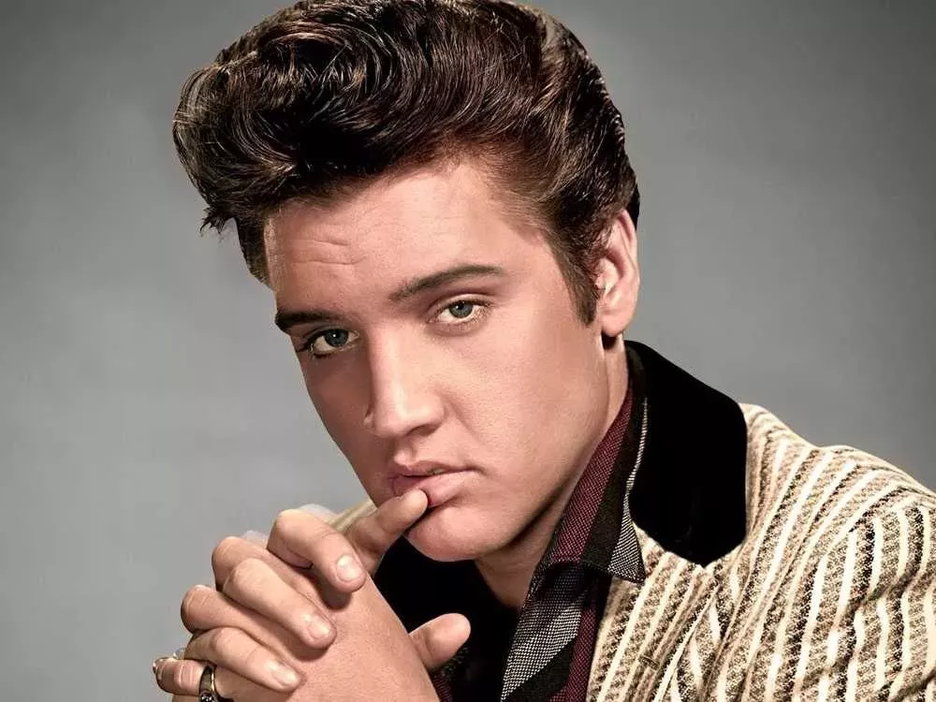
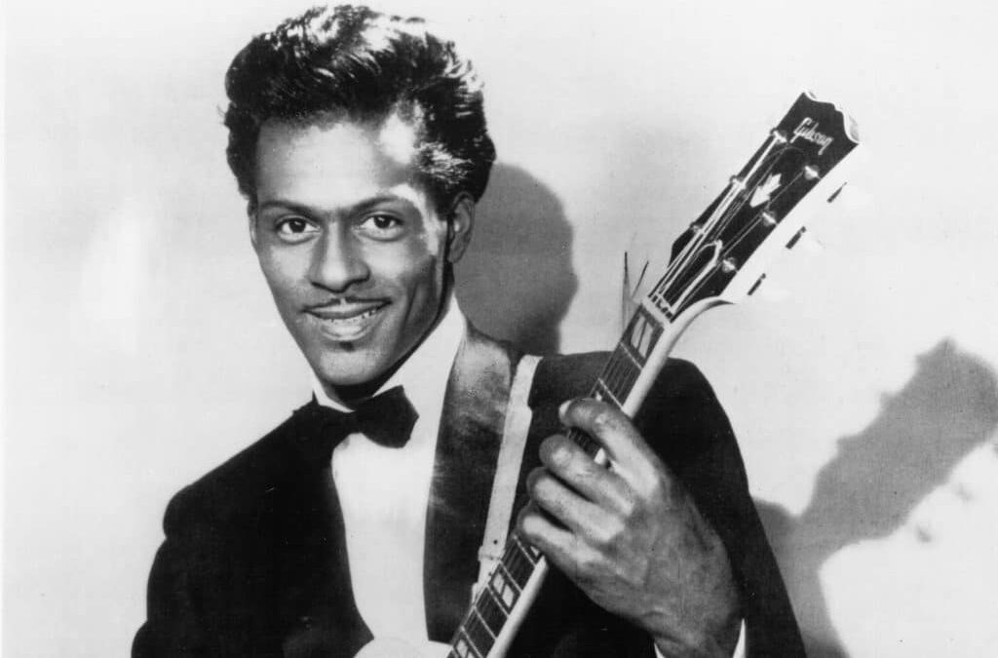
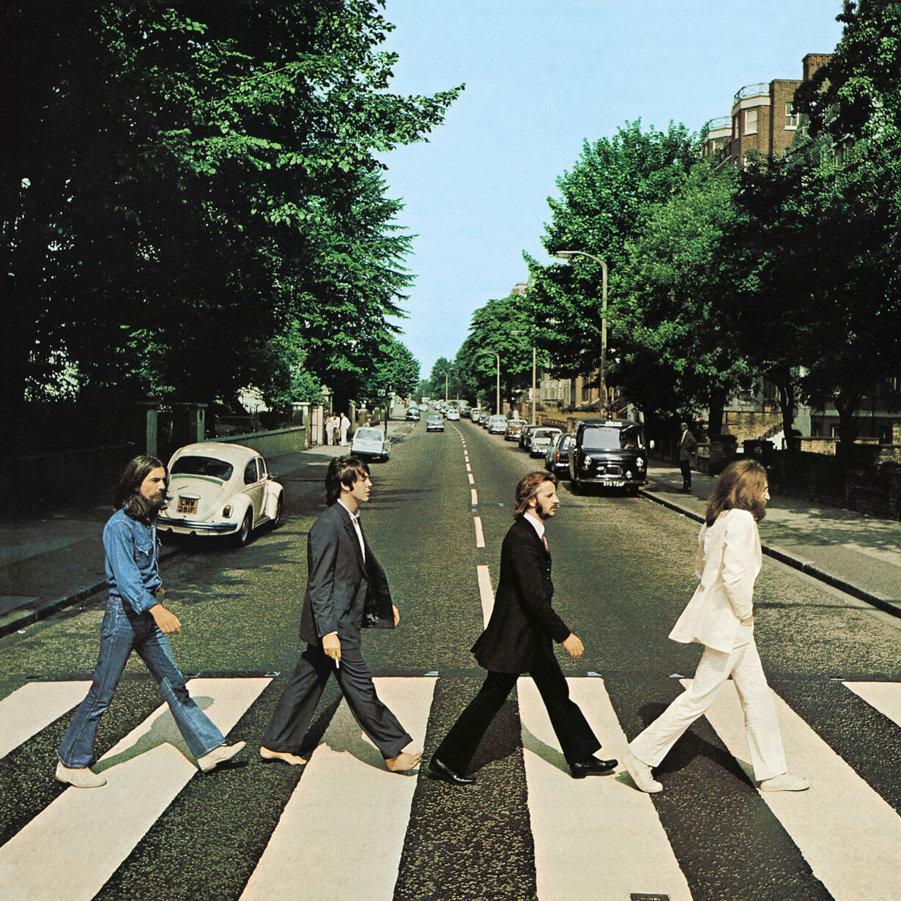
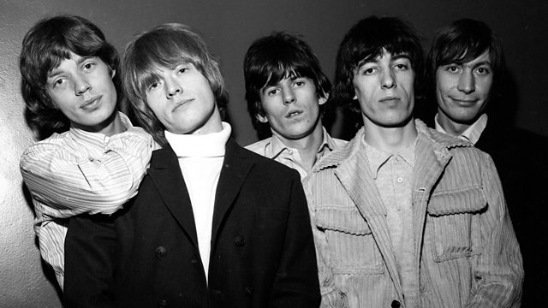
MUSIC
Begin with soul music topping the charts.Was listened to:
_ELVIS PRESLEY
_CHUCK BERRY
_THE BEATLES
_THE ROLLING STONES

Slide 4
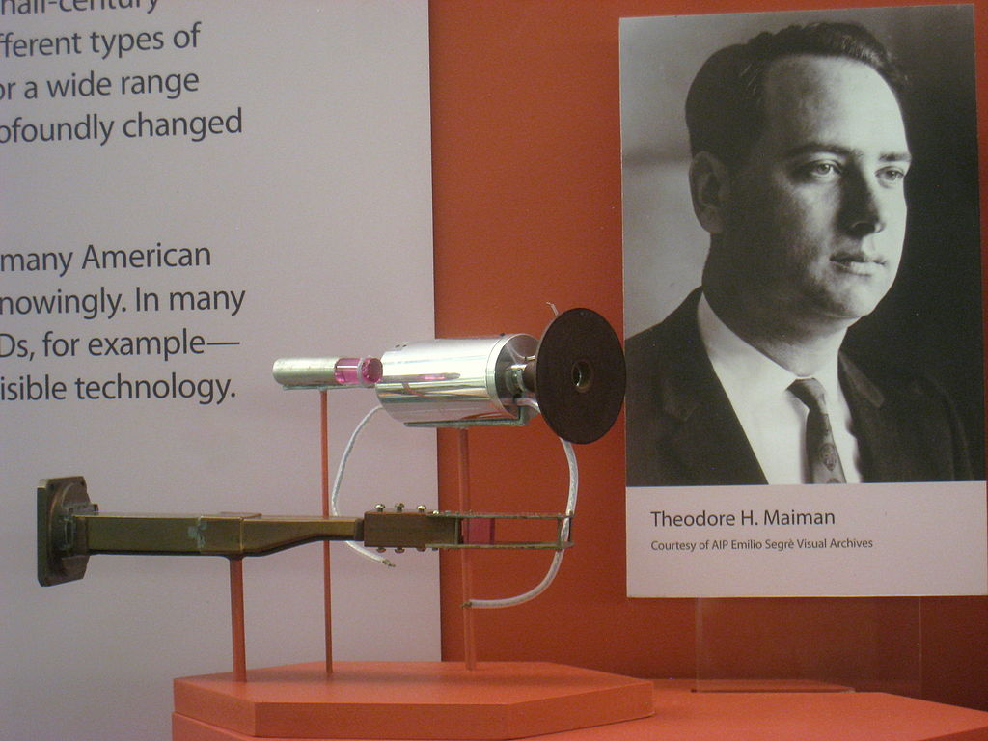
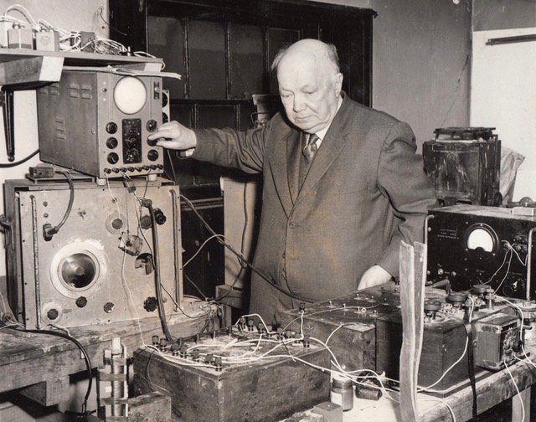
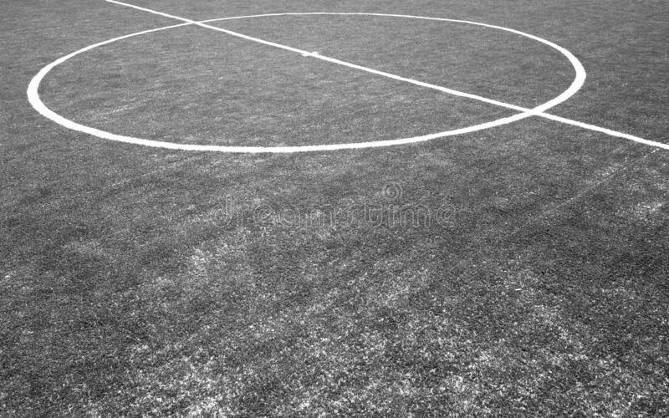
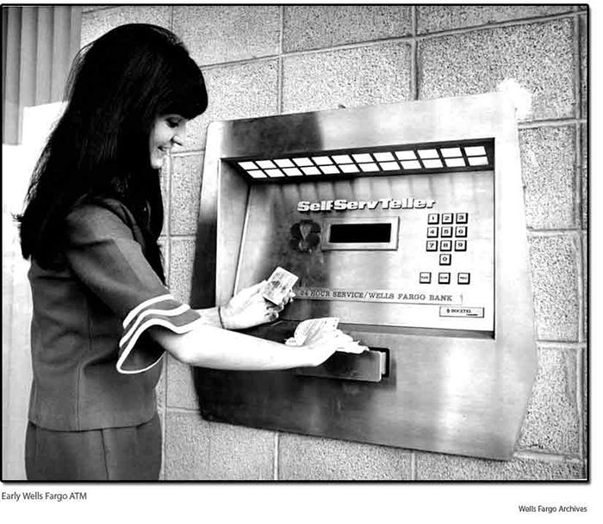
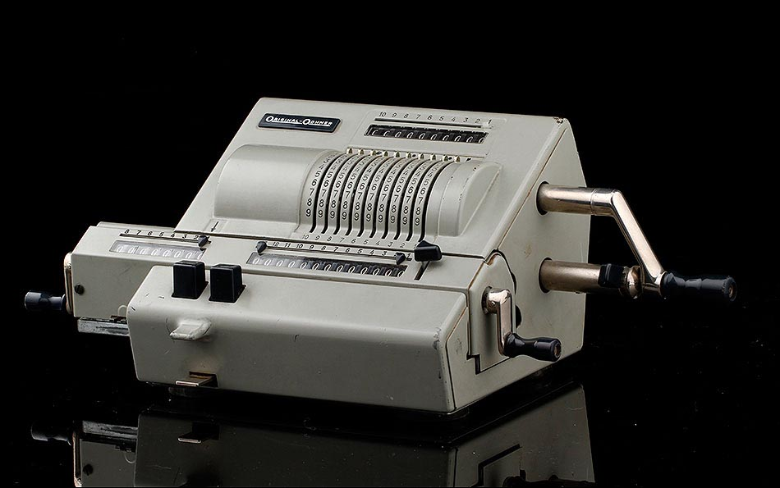
TECHNOLOGY
The radio it was one of the great inventios and there were models of all sizes,the laser, the LED, the artificial turf, the ATM and the calculator were inventad

Slide 5

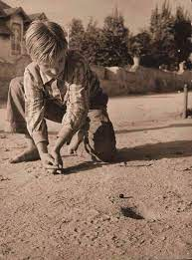
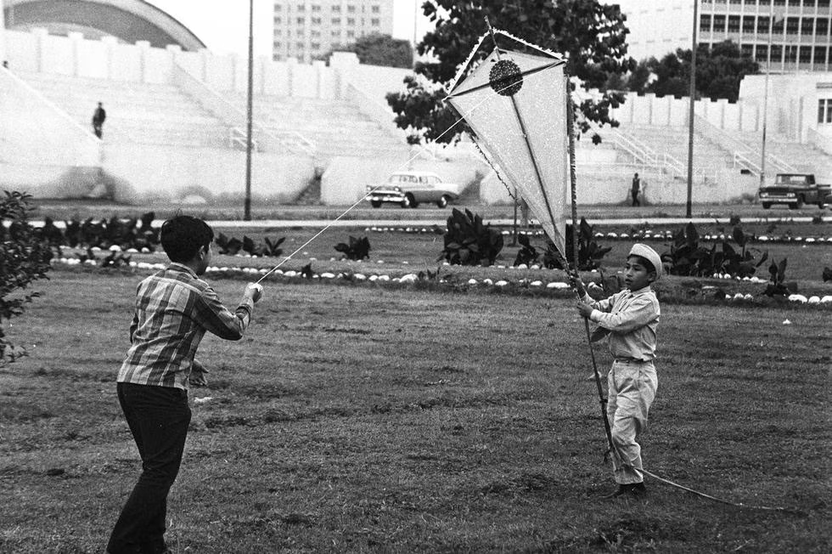
CRAZES
Some of these endearing games were:
_ HOTPSCOTCH
_ MARBLES
_KITE

