Slide 1
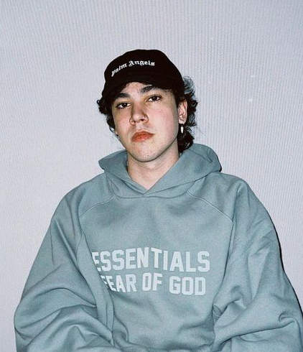
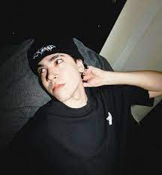
Presentation
Spreen
I’m going to talk a Little about Spreen’s life
Nombre:Guadalupe Segura

Slide 2

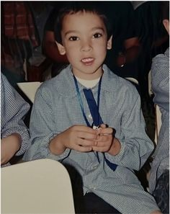
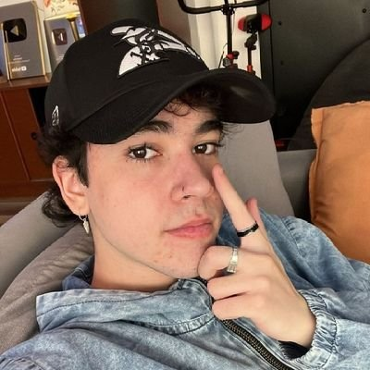
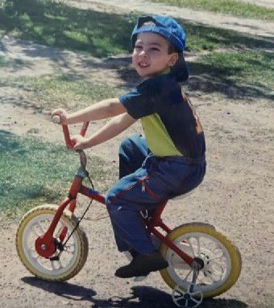
¿Who is Spreen?
☆Spreen is the number one youtuber and streamer in Argentina and his real name is Ivan Raul Buhajeruk,he was born on october 11,2000 in Santa Fe and is currently 23 years old.

Slide 3
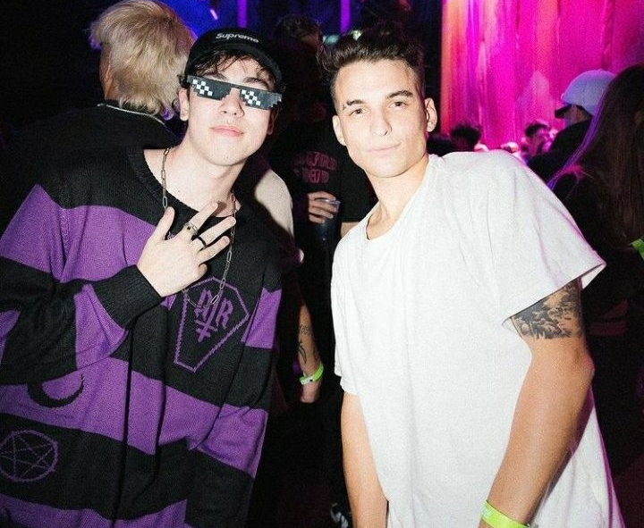
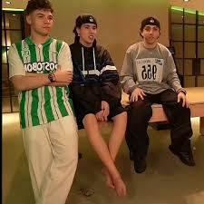
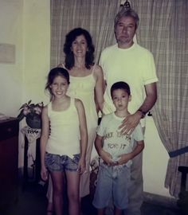
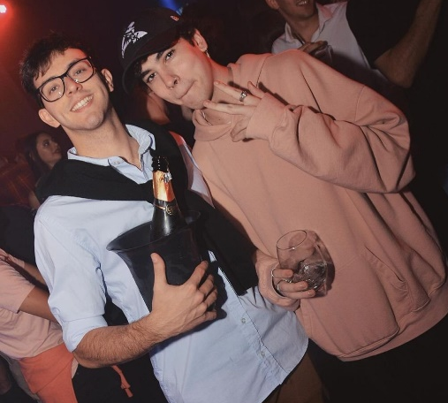
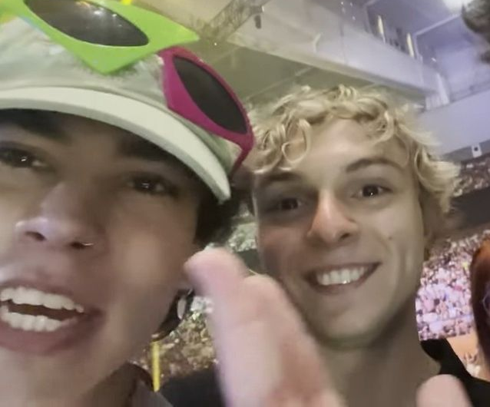
¿How is your family and Friends composed?
☆His family is made up of his mother, father and his older sister.Now he lives alone and has kitten called Micha.He has many Friends but his most important friends are Carre,Uni,Ale,Goncho and Oscu.

Slide 4
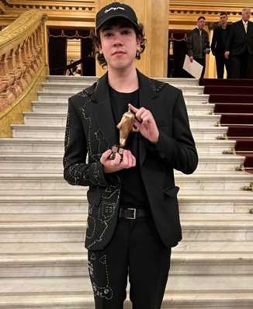
¿What did Spreen achieve throughout his career as a streamer and youtuber?
☆Spreen became the record streamer in Latin America.With 442 thousand, it reached the máximum peak of viwers in the región and surpassed the mark that belonged to Coscu with the CAA(426K).It has 4 silver plates,4 gold plates,3 CAA awards, an esland, it is the biggest streamer in Argentina, has a gold record for his song ”A casa pete” and has another song with his friend Carre called “Minina”,has an energy drink “spreenXspeed”,a collaboration with trident,Xbox and McDonald’s,did a ive show 24 hours in the obelisk and has 8.5 milion subscribers on Twitch and 6.85 million on Youtube,finally,it has 4 other channels that have more tan 1 million subscribers each

