Slide 1
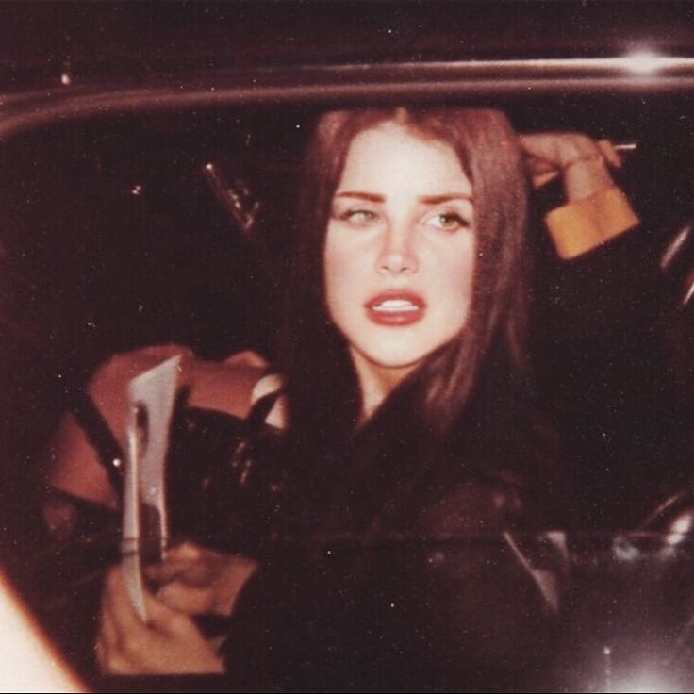
presentation of lana del rey
GUILLERMINA FUENTES
Course 2B
Santa Rosa del Lima
teacher : Laura chavez

Slide 2
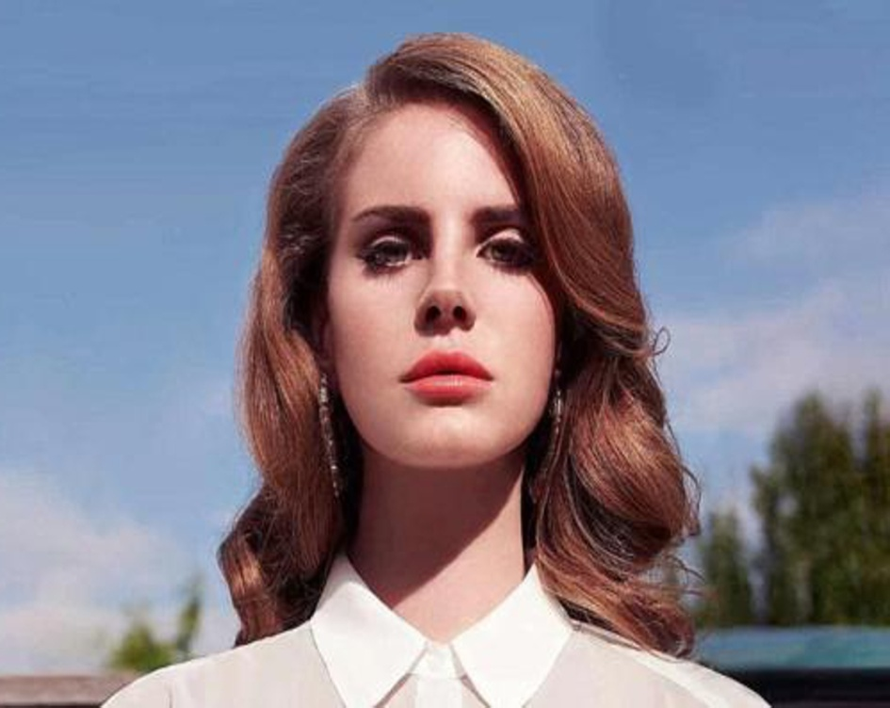
LANA DEL REY
Her name is Elizabeth Woolridge Grant, known artistically as Lana Del Rey, she is an American singer, songwriter, model, actress, writer, producer and poet. She was born on June 21, 1985 (age 38) in Manhattan, New York

Slide 3
about his career
She started her career in 2005 but she rose to fame at the end of 2011 when she released a video clip for her song "videogames", which has more than 15 million views on YouTube thanks to her great albums such as honeymoon, lust for life, Lana continued. gaining fame, millions of followers and the respect of the music industry and his entire community which calls itself “Gangster's”

Slide 4

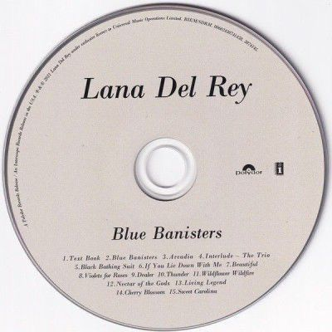
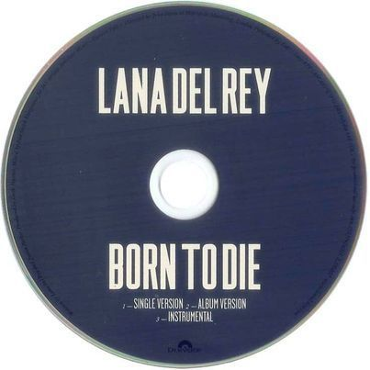
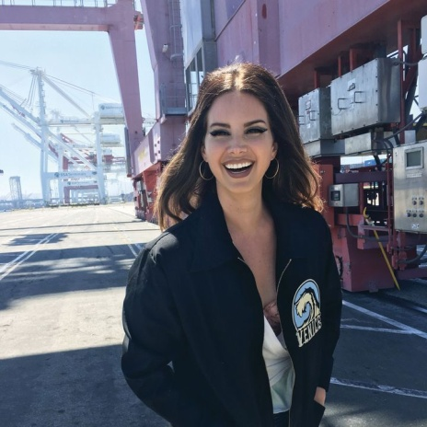
his great fame
She has a total of 16 albums but the most famous are Born to Die or Ultraviolence which have won several awards. In total throughout her career she has won 38 awards out of 96 nominations. She was recognized as the Variety Decade Award at the Variety HitMakes Awards. She is also the first woman to receive the visionary awards at the billboard women in music awards 2023, in 2014 her song young and beautiful was nominated in the category of best song written for a film in 2018, her album lust for life was nominated in the category of best pop vocal album. In 2020 Norman Fucking Rockwell in the album of the year category also won 2 awards at the BRIT awards and 2 at the MTV Europe Music Awards
She is my favorite artist cause she is so pretty and my favorite song of her is cherry and videogames <33
j

