Slide 1
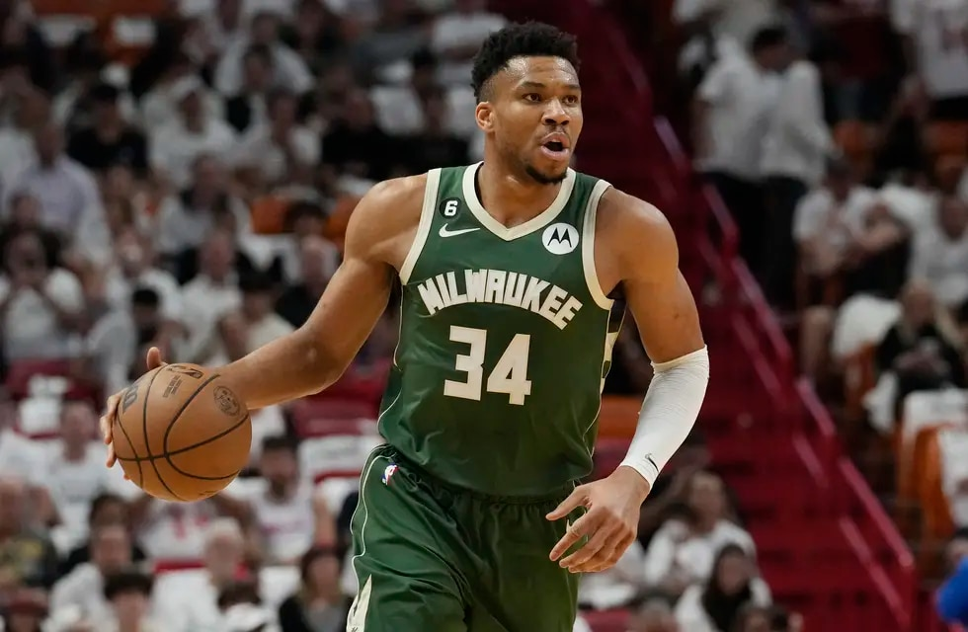
Giannis Antetokoumpo

Slide 2
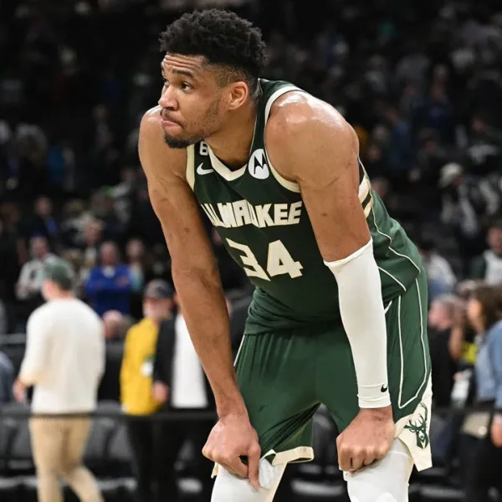
How old is he?
He is twenty nine years old

Slide 3
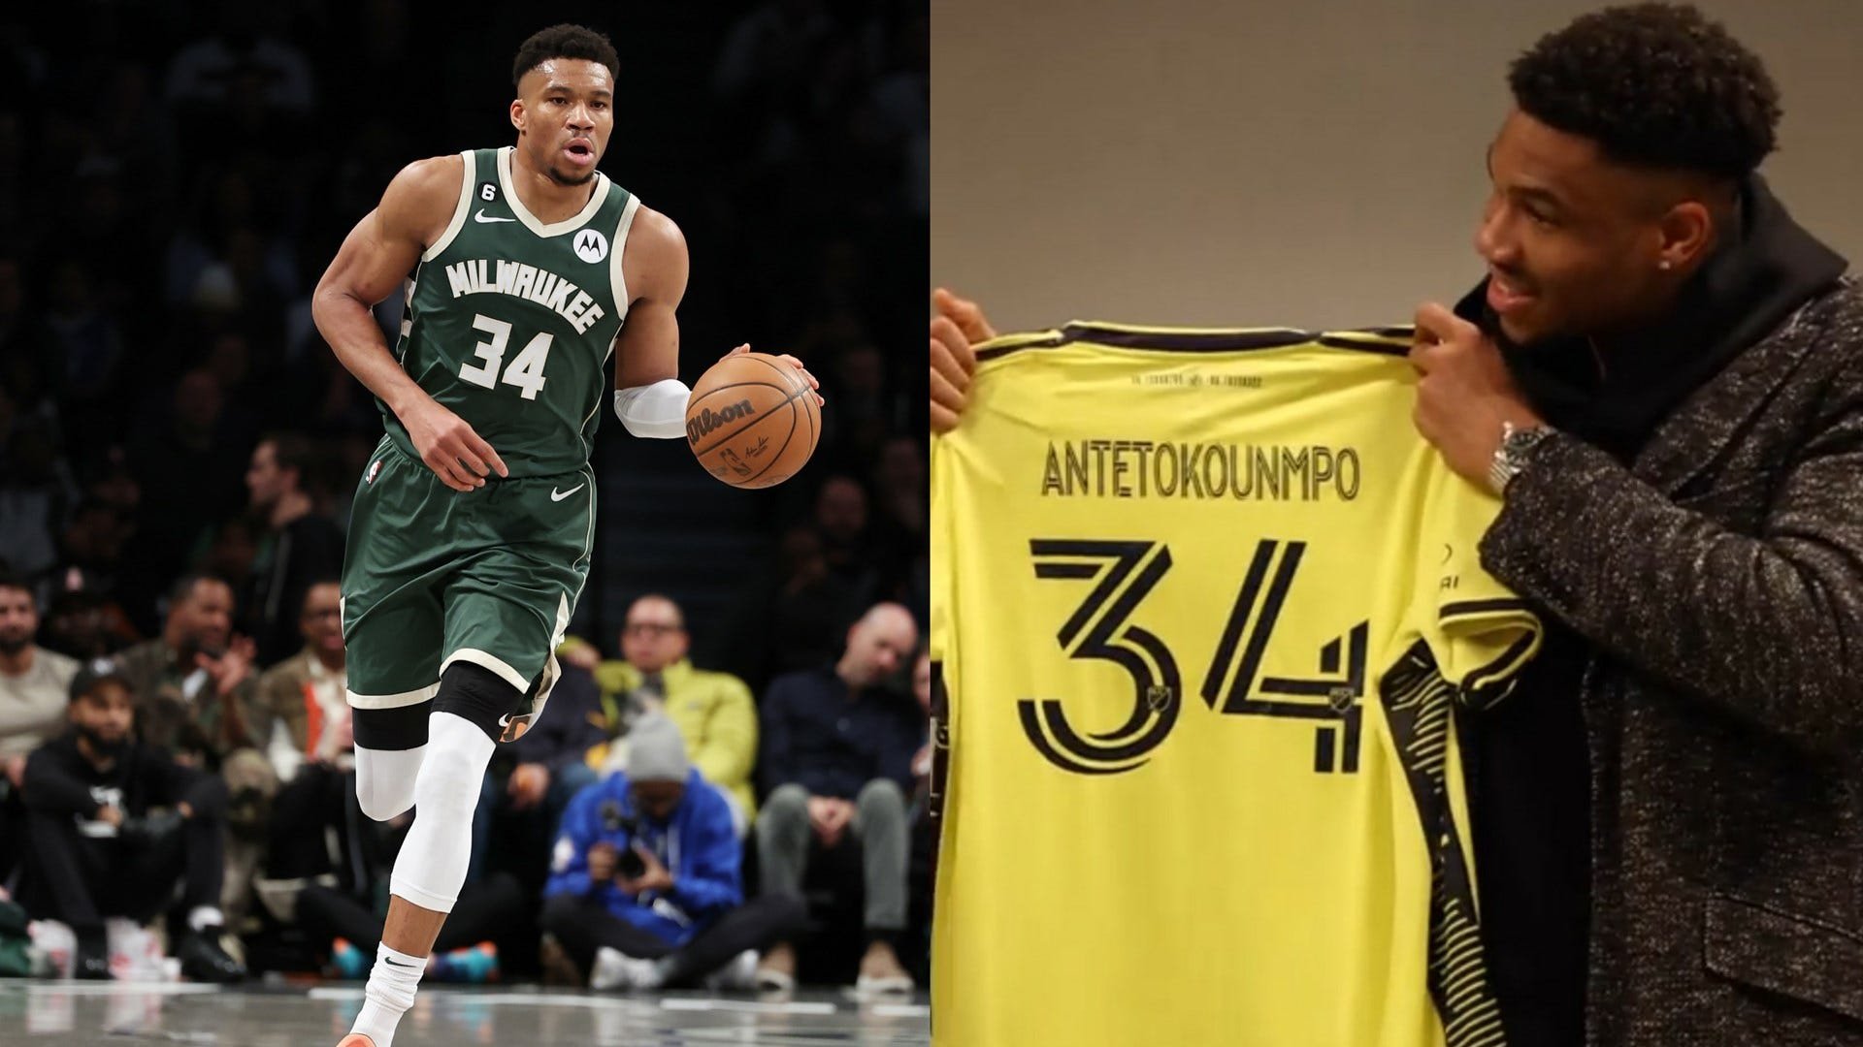
Why are they famous?
Because he is the best player of basquetball for me

Slide 4
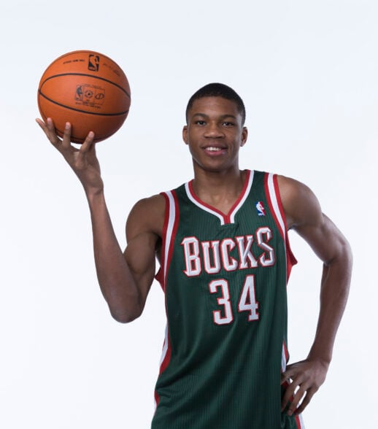
Why are they the famous?
Because he is humble and empathetic. He is a great basquetball player

Slide 5
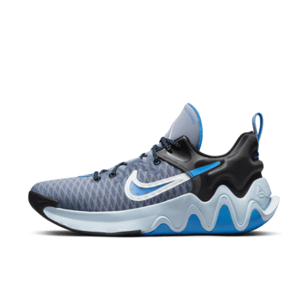
Your sneaker Brand
He has is own sneakers Brand called Antetokoumpo

