Slide 1
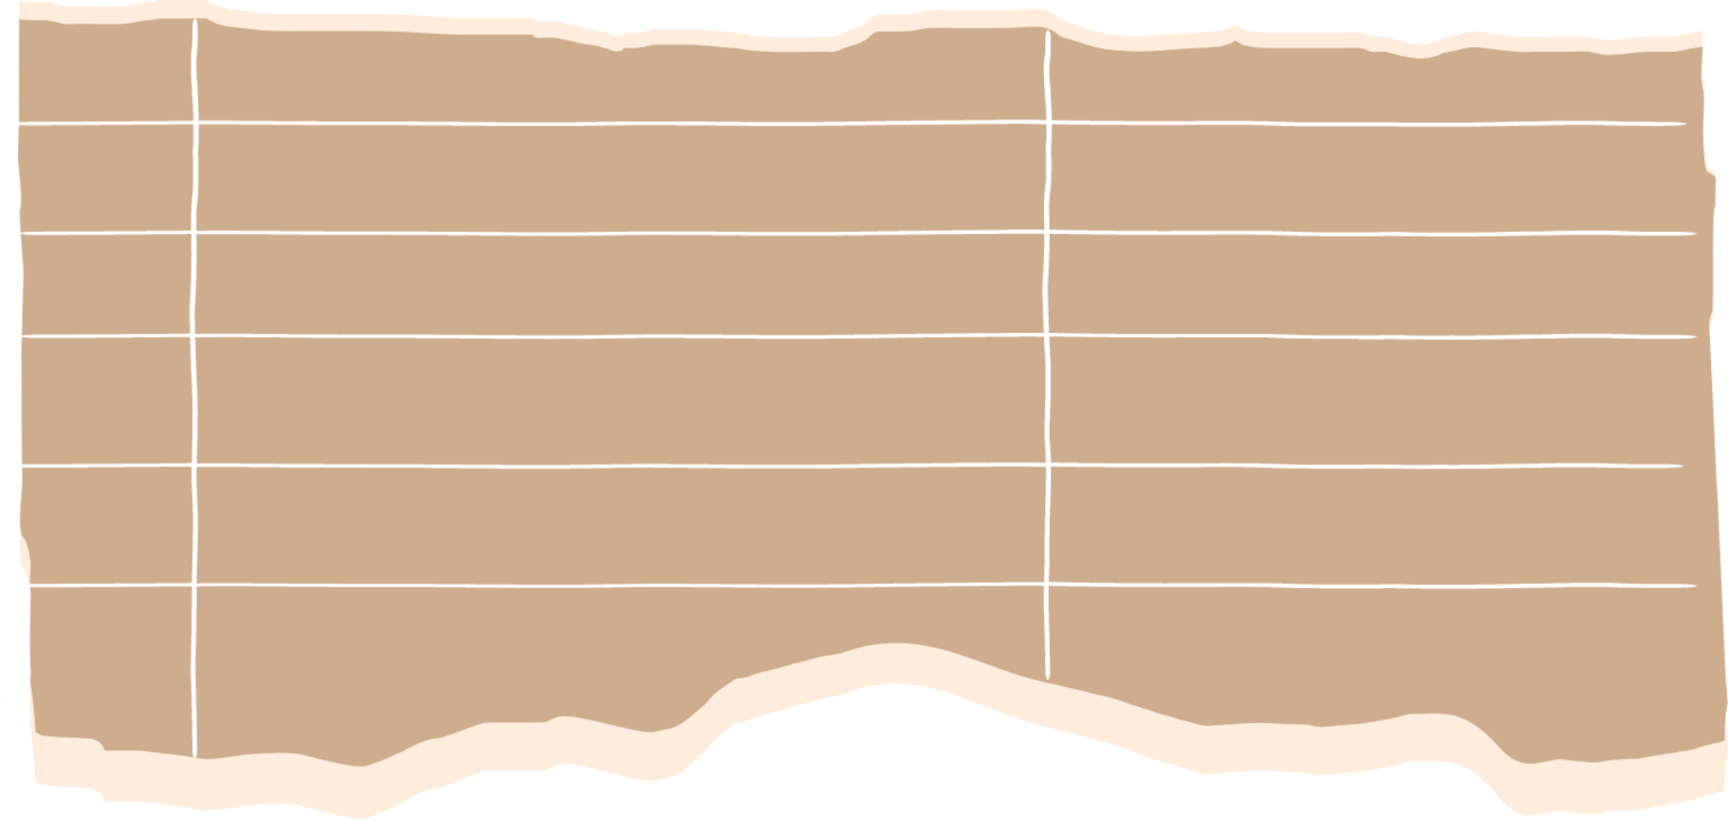
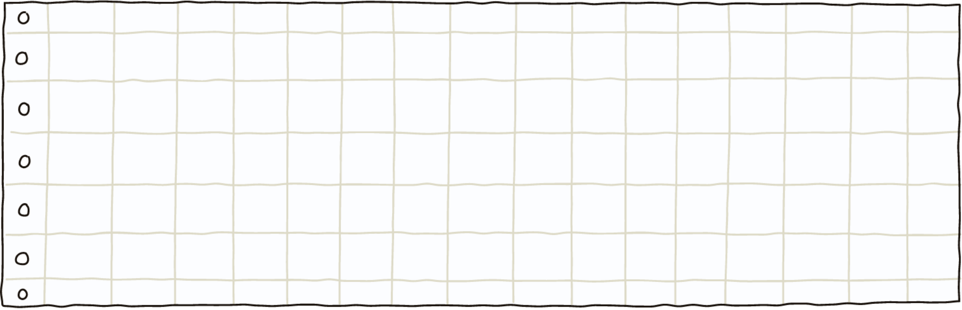

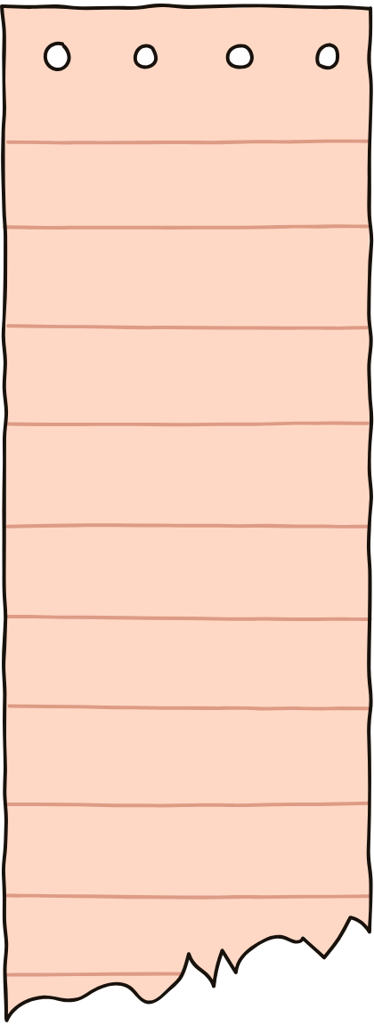
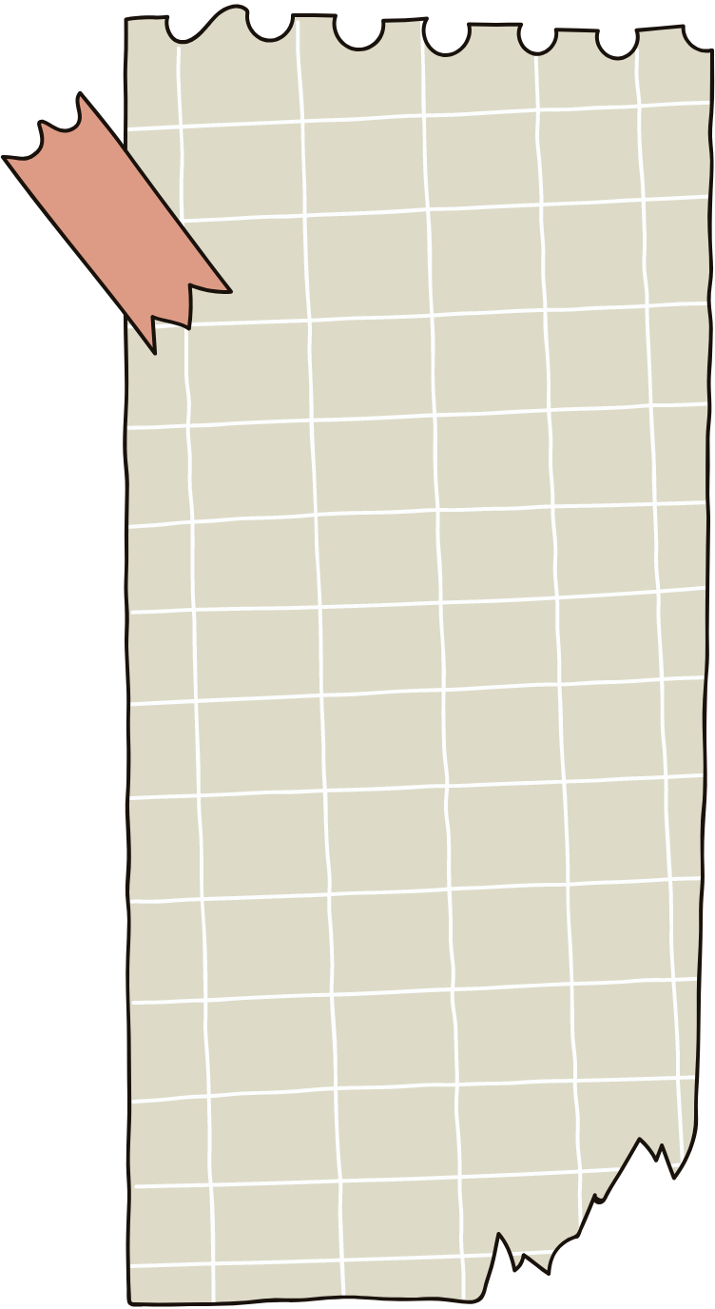
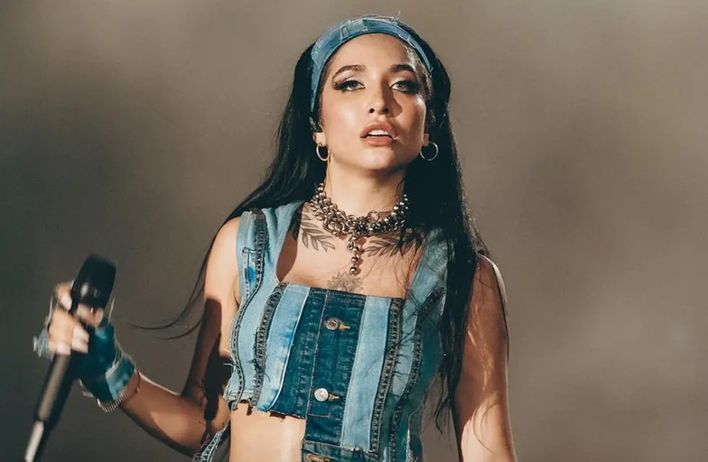
MARíA BECERRA
Famous singer....

Slide 2
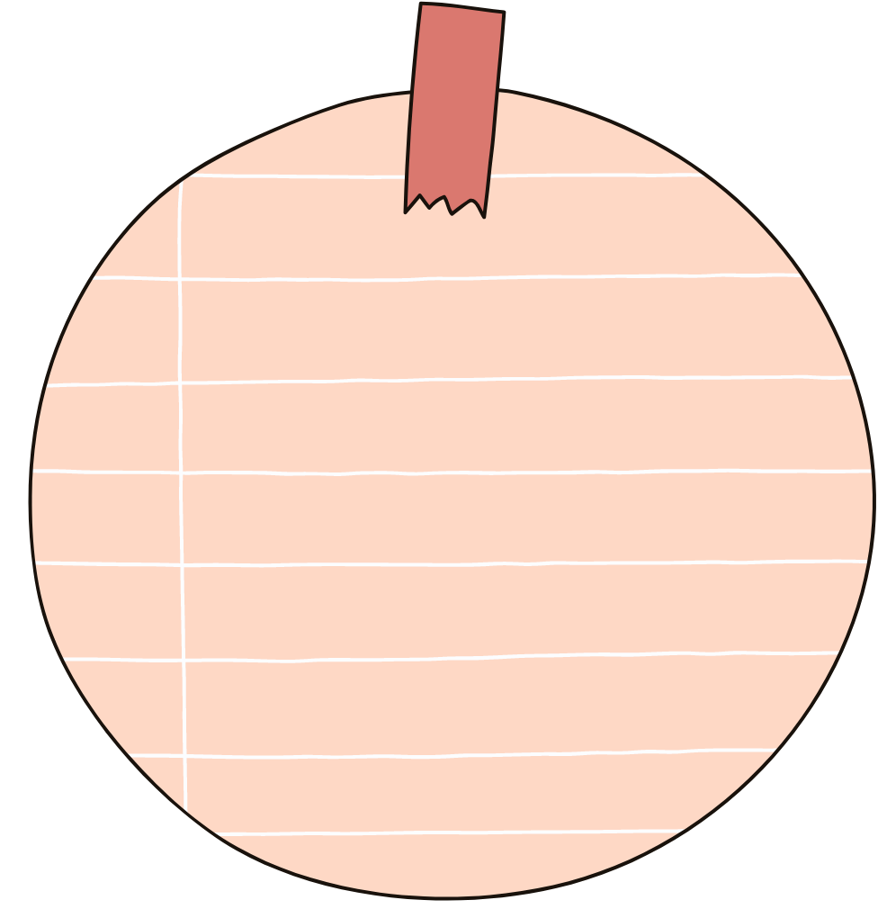
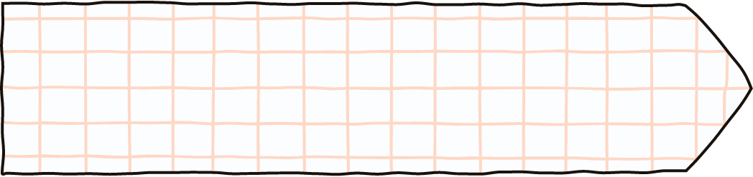
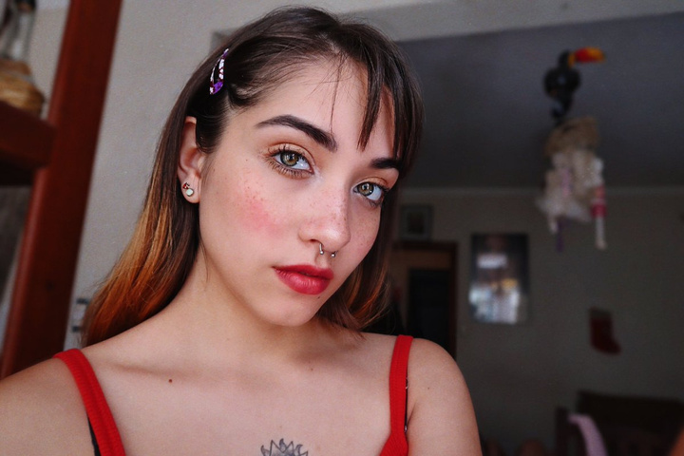
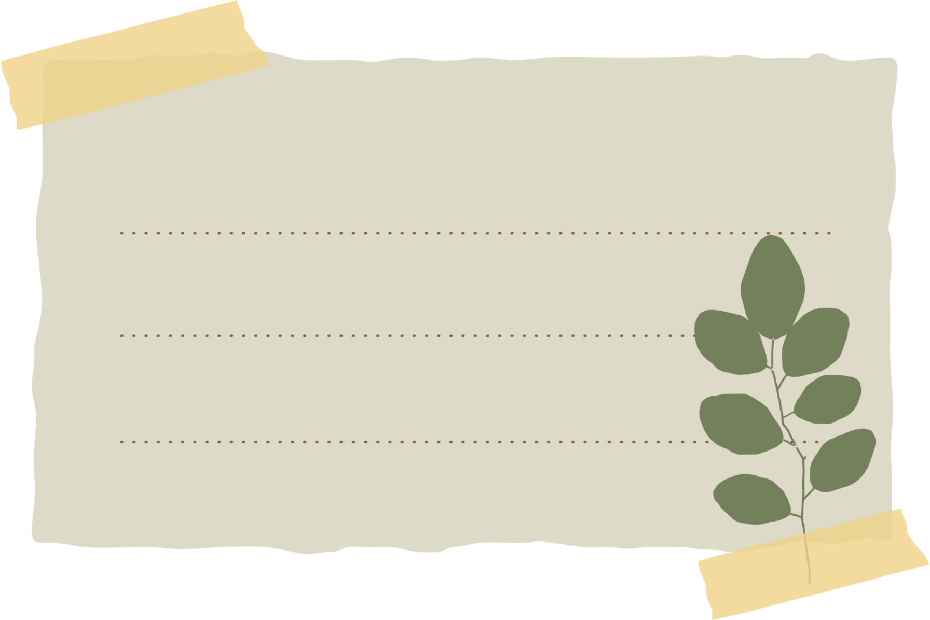
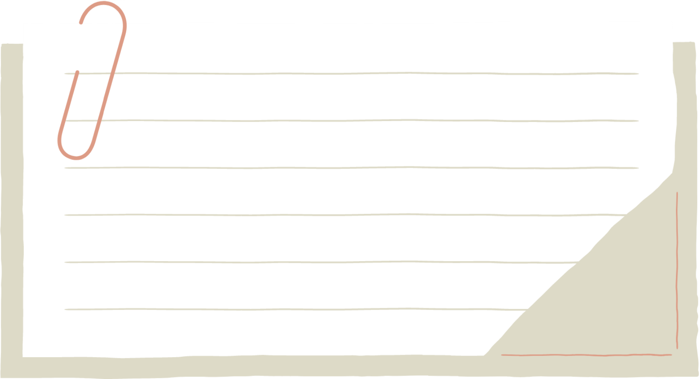
Data to take into account
She was born on february 12,of the year 2000 in the city of Quilmes
she is 23 years old and launched herself as a singer in 2019 with her álbum "222"
At only 12 years old she started posting videos on Facebook and when she turned 15 she created her YouTube channel

Slide 3


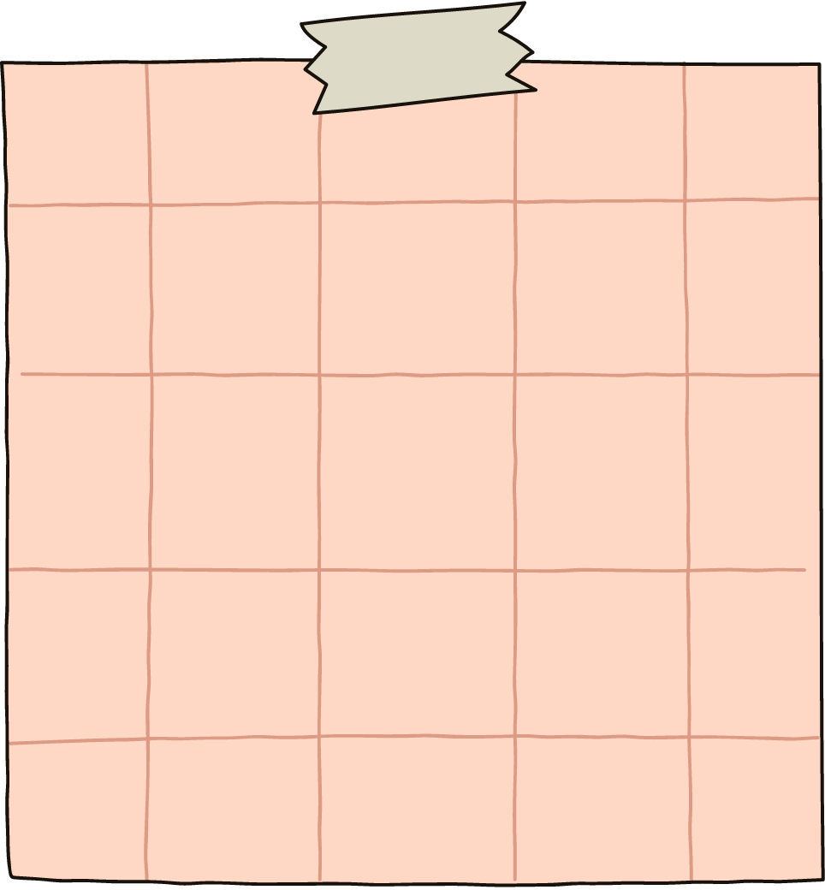
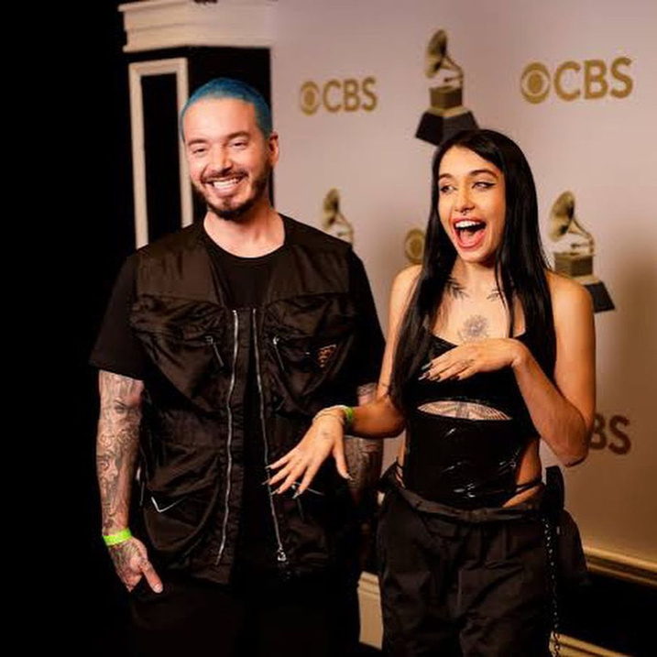
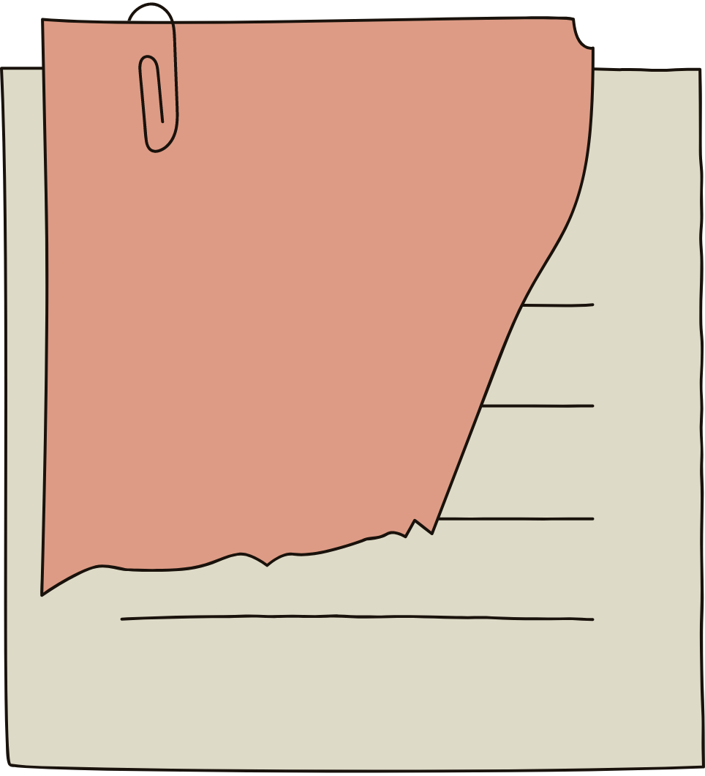

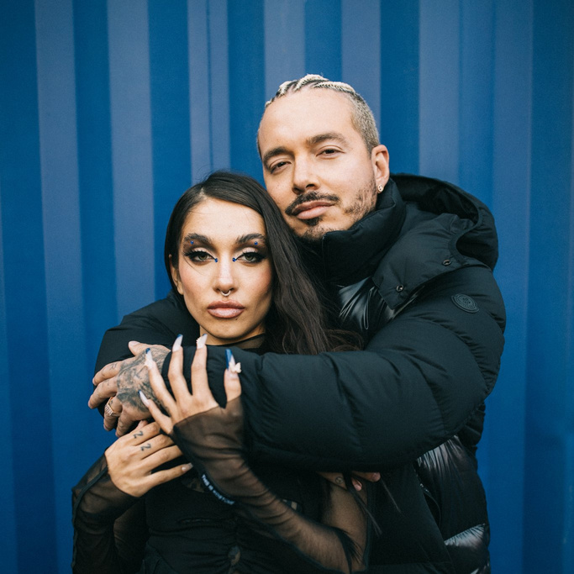
An important mention was her collaboration for a song with J.Balvin titled "que más pues?", with this song her fame began to increase, she was super happy since this song had a lot of support, it currently has 653M views and is his most viewed song on his YouTube channel
GRAMMY 2022
RECORDING OF "Que más pues?"

Slide 4
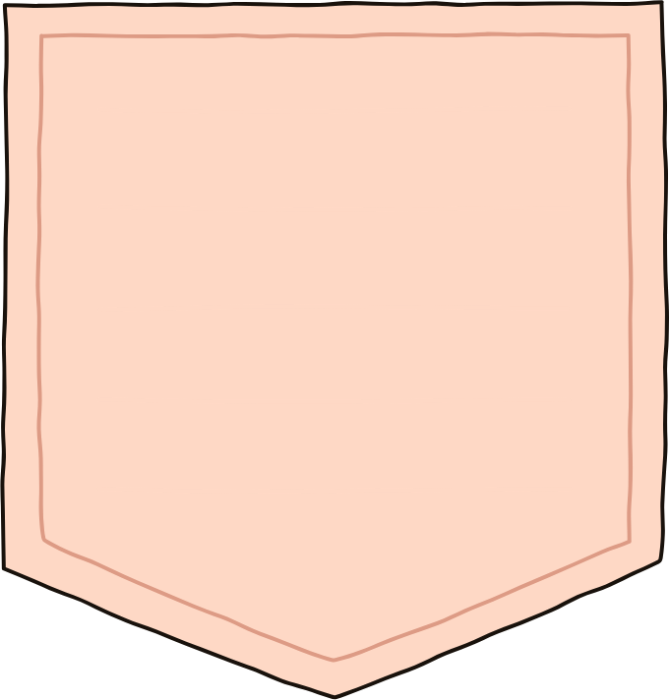
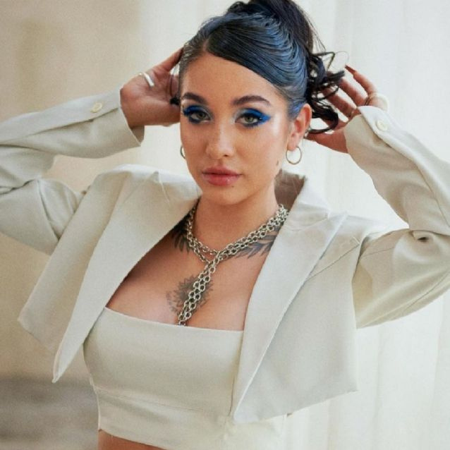


She is a great artist who grew throughout her career, her songs are significant for the public, she is positioned among one of the great Argentine singers, she is nicknamed "la nena de Argentina"

Slide 5

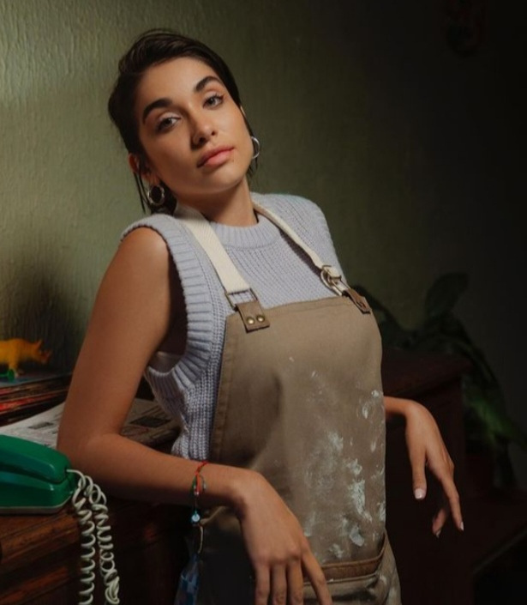
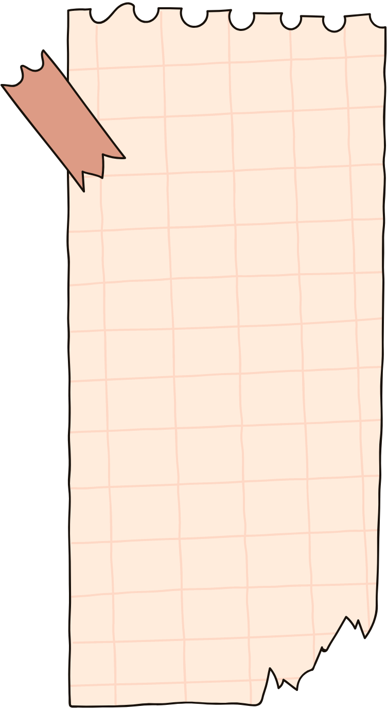
My favorite song is "Corazón Vacío" it is a very viral and very significant song
Delfina Moreno 2 "B"

