Slide 1


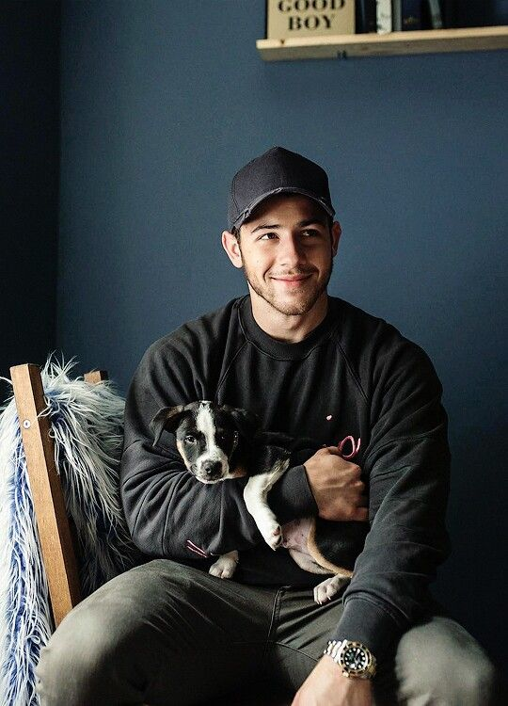
Famous person
NICK JONAS

Slide 2



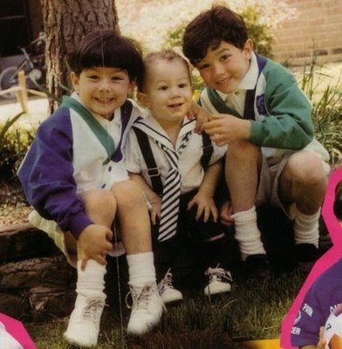
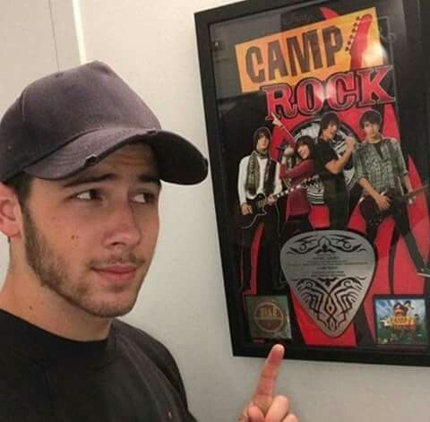

Nicholas Jerry jonas better know as Nick jonas , is american Singer , musicion, actor, producer and musical director , member of the bands Jonas Brothers.
He began his artistic career as an actor in Broadway musicals, including 'Beauty and the Beast' and 'Les Miserables’.
In 2006 he joined his brothers to create a new band called Jonas Brothers with which they released their first album It's About Time.
On June 20, 2008, Camp Rock was released, his first movie to premiere on Disney Channel. In addition to working with his brothers, he also worked with the singer Demi Lovato. Also on May 2, his first series with his brothers titled JONAS premiered, which could be seen on Disney Channel.

Slide 3
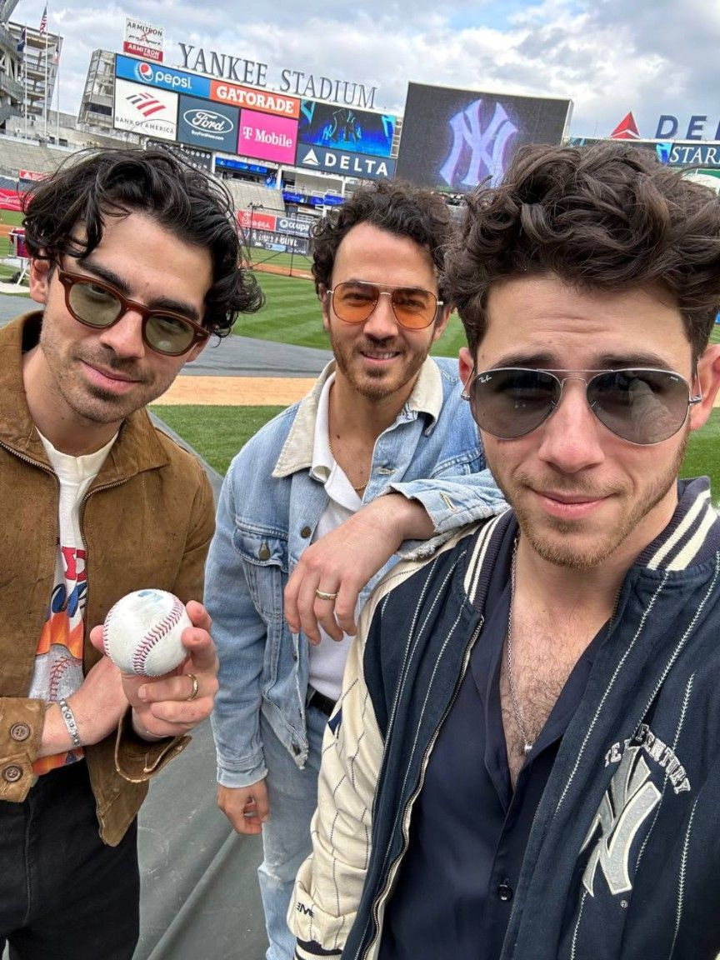
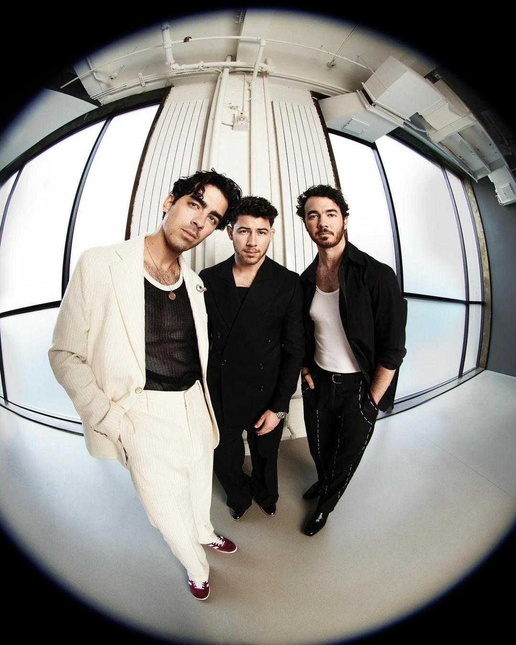



Important data :
He was born on September 16, 1992 in Dallas, Texas, USA. although he grew up in Wyckoff, New Jersey.
He is the brother of fellow artists Kevin Jonas and Joe Jonas, with whom he formed the group the Jonas Brothers in 2005, with a period of activity until 2013.
He is the youngest of the 3 brothers.
Son of Denise Miller, singer, and Paul Kevin Jonas, composer and musician, he also has a younger brother, Frankie Jonas.On August 18, 2018, Nick Jonas announced his engagement to Priyanka Chopra through the social network Instagram with a series of photographs. The artist also shared some images of the engagement celebration in India.

